Slide 1
PLUM BOROUGH SCHOOL DISTRICT CHAPTER 339 SHOWCASE
Christine Bossung, Center and Regency Elementary Schools
Jena Nese, Holiday Park Elementary School
Amy Palumbo, Pivik Elementary School
Michele Markiewicz, O’Block Junior High School
Joe Miller, O’Block Junior High School grade
Rob Fekety, Plum High School (A-Do)
Kerry Plesco, Plum High School (Dr – La)
Nadia Abbondanza, Plum High School (Le-Rh)
Brian Betta, Plum High School (Ri-Z)

Slide 2
District Demographic Data (2015-2016)
Center and Regency Elementary Schools (K-6) 703:1
Holiday Park Elementary School (K-6), 647:1
Pivik Elementary School (K-6), 612:1
O’Block Junior High School (7-8), 600:2
Plum High School (9-12), 1,300:4

Slide 3
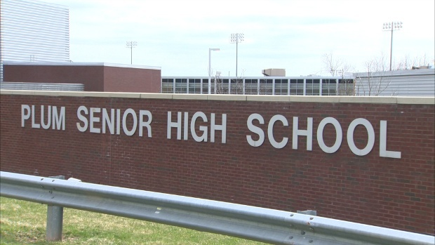
District Demographic Data (2015-2016)
Senior Class 311 students:
Graduation Rate-99% - 2 out of 311 did not graduate
Where graduates go after high school
4 Year College/University – 70%
2 Year Programs – 16%
Workforce – 8%
Military – 4%
Undecided -2%

Slide 4
Career & Technical School Data
Enrollment:
2015-2016
83 students out of 1251 = 7%
Full Day/Apprentice – 26 students
PM students – 18
AM students – 39
All 2015-2016 Sophomores and Juniors who were eligible to continue their programs returned to the CTC minus 1 student = 98% return rate

Slide 5
Career Domain Program Goals
ELEMENTARY: Career guidance lesson delivery for all grade levels (K-6) during the 2016-2017 school year
ELEMENTARY: Career Fair in May 2017 for 5th grade
ELEMENTARY: Development of a career interest portfolio (PA Career Zone) for 6th grade students during the 2017-2018 school year. Have Junior Achievement partner with school to provide 6th Grade with entrepreneur classes during the 2017-2018 School Year – STEM Shark Tank.
JUNIOR/SENIOR HIGH SCHOOL: Implementation of a Parent Night during the 2016-2017 school year for 8th grade students prior to course selection
JUNIOR/SENIOR HIGH SCHOOL: Development of an academic/career plan for every 8th grade student by the end of the 2017-2018 school year
JUNIOR/SENIOR HIGH SCHOOL: Ongoing guest speakers 1x a week for grades 9-12 regarding careers and career preparation for the 2017-2018 school year

Slide 6
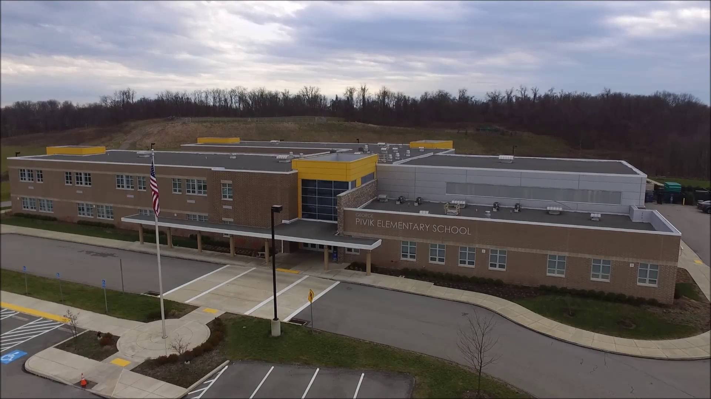
Stakeholder Group: Students
Big Idea:
Students will play an active role in planning to develop goals related to their interests, abilities, and future plans. Students will receive curriculum focused on academic, career, and personal/social skills in order to make educated decisions that will lead to their successful future. Students will participate on the advisory council.
By exploring and developing a career identity from kindergarten through the twelfth grade they will become more observant and aware of their opportunities within the community in which they live. Students within this model will be able to provide feedback to counselors regarding program effectiveness. Their input will assist counselors in the design and implementation of programs that are efficient, effective, and utilize methods that are best suited in reaching their peer group. Students will be represented on the district advisory council.
Interventions
Participation in K-6 guidance curriculum
Academic/career plan development in 6th and 8th grades
Job shadowing in 8th and 10th grades
Career fairs/presentations
Mock interviews and interest inventories
Measurement
Surveys
Student input during Advisory Council meetings
Outcome
Gathered student support and ideas from Advisory Council meeting
Increased career awareness and planning
Decrease the number of students who report having unknown plans after graduation
Interventions will be assessed during 2016-2017 school year

Slide 7
Stakeholder Group: Parents
Big Idea
Educate parents about the K-6 Career Awareness Program. Will be informed of school counseling program activities for parents and students so parents can make informed decisions and be involved in their child’s education
Parent representatives from each school level included on the Advisory Council for input
Interventions
Invite parents to participate in orientation and Parent Night for grades 6, 7, and 8
Include parents during academic plan meetings for 8th grade students
Invite parents to participate in and attend the Elementary Career Fair
Measurement
Attendance rates at school-sponsored events
Surveys
Parent input during Advisory Council meetings
Outcome
Gathered parent support and ideas from Advisory Council meeting
Interventions will be assessed during 2016-2017 school year

Slide 8
Stakeholder Group: Educators
Big Idea
Supports the school counseling program through participation in curriculum development and delivery, graduation project completion, and building relationships with students and parents
Education representatives from each school level included on the Advisory Council for input
Interventions
Assisting students in recognizing the relation between curriculum and career interests
Building relationships with Business/Community representatives to provide career-community links
Incorporating career awareness activities into professional development
Measurement
Needs survey on electives desired by students
Graduation Project
Outcome
Gathered educator support and ideas from Advisory Council meeting
Feedback from teachers and students

Slide 9
Stakeholder Group: Business/Community
Big Idea
Involving representatives in curriculum development
Providing career opportunities for students
Business/Community representatives from local area included on the Advisory Council for input
Intervention
Job shadowing experiences
Part-time employment/Co-op experiences
Career Day/Classroom presenters
Measurement
Surveys
Collect data on job shadows and employment
Outcome
Gathered business/community support and ideas from Advisory Council meeting
Improved match between employer needs and student preparation

Slide 10
Stakeholder Group: Post-Secondary
Big Idea
Involving representatives in curriculum development and student preparation
Post-secondary representatives from local area included on the Advisory Council for input
Communication on current trends and needs for post-secondary eligibility
Intervention
Career Day presenters
Student visits to post-secondary institutions
Facilitating meetings between post-secondary options and students
Measurement
Measuring post-secondary plans of students Survey
Outcome
Goal is decrease the number of unknowns
Help students to become aware of various post-secondary options

Slide 11
Advisory Council Meeting (Tentative)
Dr. Tim Glasspool - Superintendent | Nadia Abbondanza – HS School Counselor | Michele Markiewicz – Jr. High School Counselor
Justin Stephans – Interim High School Principal | Brian Betta – HS School Counselor | Joe Miller – Jr. High School Counselor
Joe Fishell – Junior High School Principal | Rob Fekety – HS School Counselor | Christine Bossung – Elementary School Counselor
Jason Knisley – Elementary School Principal | Kerry Plesco – HS School Counselor | Jena Nese – Elementary School Counselor
Jeff Hadley – Elementary School Principal | Elizabeth Strenkowski – Post Secondary | Amy Palumbo – Elementary School Counselor
Jennifer Marino – Post Secondary | Melissa Matthews – Business/Community | Susan Doyle - Parent
Doran Check – Parent | Ginny Spangenberg – Parent | Marc Serrao-Business/Community
Student – 12th grade student | Student – 8th grade student | Student – 5th grade student
Rob Fekety – High School Counselor

Slide 12
Advisory Council
Purpose: To inform, guide, and assist the development of the Chapter 339 program of the Plum Borough School District.
Ideas:
Assist school counselors by advising on program goals
Reviewing program results
Making recommendations about the school counseling program
Advocating and engaging in public relations for the school counseling program
Advocating for funding and resources
Tentative Meeting Date: May 17, 2017

Slide 13
Impact of Chapter 339
Increased data collection due to Scuta data gathering software
Increased career awareness due to Naviance post-secondary planning tool
Increased awareness of the Career and Technical Center to all staff members in entire district
Increased career awareness at the Junior High level due to Plum library career awareness series

Slide 14
Thank You !!
Plum Borough School District Chapter 339 Showcase

